Slide 1


KÖDISPACE 4SG
Engineered for Extreme Climate Performance
Made for the Middle East Proven to last for decades
www.mannaglass.sa

Slide 2
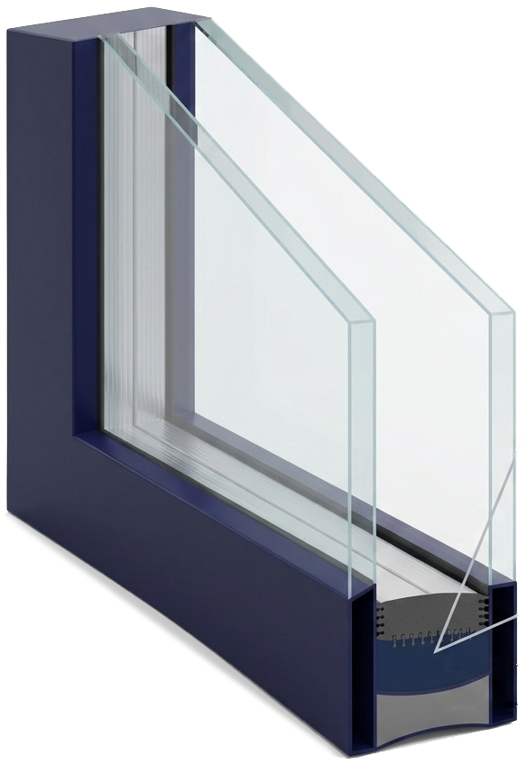
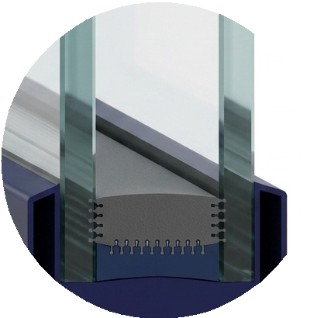
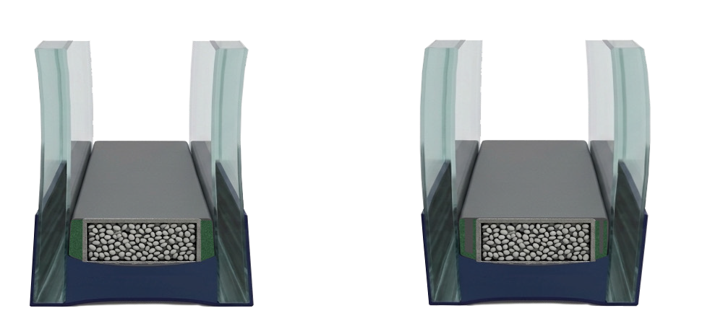
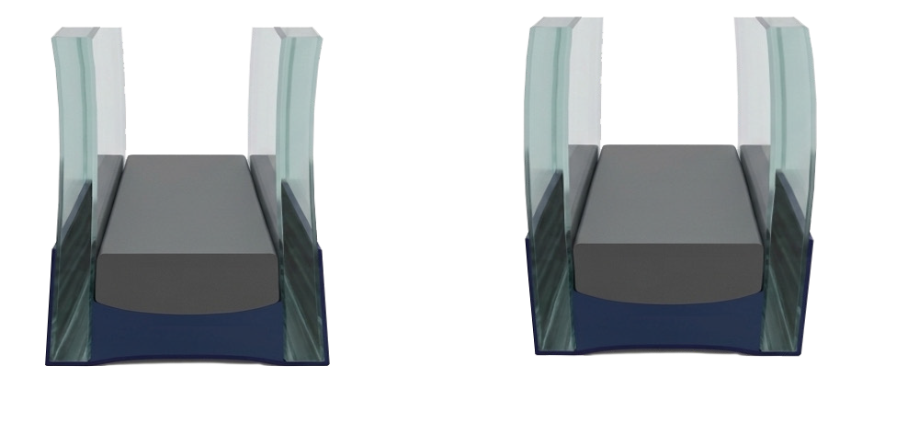
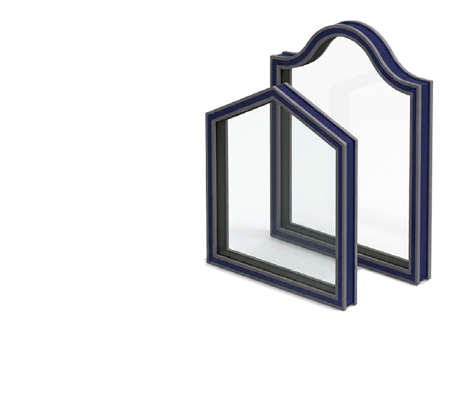
2
mannnaglass.sa | Manna Glass
Ködispace 4SG - The Technology
The World‘s Best Performing Reactive Warm Edge Spacer
Ködispace 4SG provides a unique reactive chemical bond with glass and silicone - creating a perfectly sealed, unified system.
Traditionally, spacer systems consisted of three or four components: an aluminium spacer bar, a moisture-absorbing desiccant inside the bar, a butyl primary seal on the bar’s edge, and a secondary sealant connecting all components.
Recently, this system has been upgraded to a three-in-one solution for the spacer, desiccant, and primary seal functions, known as TPS (Thermoplastic Spacer Systems).
Ködispace 4SG
Glass
Glass
Ködispace 4SG from Manna Glass is a revolutionary advancement in this field of TPS technology. Whereas other TPS systems focus on an adhesive bond, 4SG goes much further, providing an adhesive and chemical connection. It combines outstanding mechanical robustness with superior aesthetics and long-term durability, even under extreme climatic conditions.
Superior in performance to more commonly used conventional thermoplastic spacers (TPS), Ködispace 4SG creates an additional chemical bond with the silicone edge seal in addition to the glass, providing significant long-term advantages:
Characteristics include:
An extremely stable edge seal by bonding individual components at a molecular level
Incredible extended service temperature ranges from
-40 °C to +90 °C
Widely certified according to EN 1279 Parts 2, 3 & 4 Beautiful visual appearance
Certifications
EN 1279
CEKAL
RAL 520/2-1
ASTM E2190
CGSB-12.8
EPD (SmartEPD- 2024-030-0154-01)
Silicone
Ködispace 4SG
Secondary Sealant
Facing the Challenges of Extreme Temperature Regions
As we know, Façades in the Middle East face some of the world’s harshest climatic conditions. Extreme heat, intense solar radiation, and continuous thermal cycling put exceptional stress on insulating glass units (IGUs), particularly at the edge of their spacer systems.
Conventional aluminium, or similar, hollow spacer systems often experience:
Butyl creep, tearing, or squeeze-out = optical deformation Relatively quick desiccant saturation = increased fogging risk Rapid loss of gas or air tightness = U-value degradation
over time leading to coating corrosion
Temperature and Stress related Edge seal deformation = performance loss due to moisture ingress
Ködispace 4SG sets a revolutionary new benchmark for hot climate applications. Engineered for the Middle East.
Ködispace 4SG is engineered to perform where conventional systems reaches its limits.
Environmental forces are constantly exerting pressure on the edge seal.
Withstands extreme thermal loads with stable performance up to +95 °C
Maintains adhesion, structural integrity, and gas retention under continuous heat and dynamic stress
Ensures uniform stress distribution Eliminates typical butyl-based failure modes
Delivers maximum durability and aesthetic quality
Allows the imagination and production of unlimited shapes, curves, and bent glass designs

Slide 3
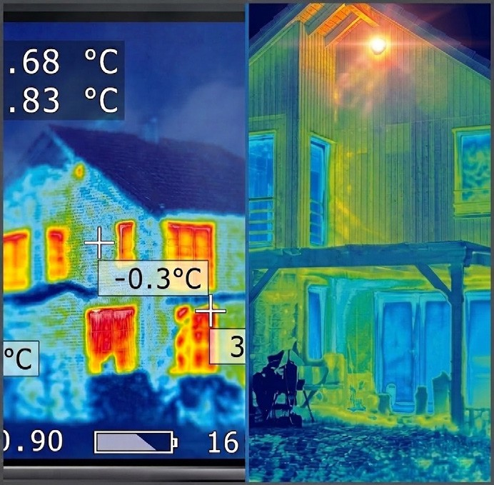

Manna Glass | mannnaglass.sa
3
Elevating Façade Performance to a New Standard
Thermal Performance
Ködispace 4SG ensures outstanding argon gas tightness, keeping insulation performance stable throughout the entire service life of the IGU.
This long-term gas retention helps maintain a consistently low U-value, which can be up to 25 % better than IGUs affected by gas loss through edge spacer leakage.
Optical & Aesthetic Quality
Conventional spacer systems often develop visible edge defects. Ködispace 4SG from Manna Glass prevents these issues through its reactive spacer technology, ensuring a permanently clean, uniform and precise edge seal.
Mechanical & Structural Performance
Designed for high mechanical and dynamic loads, Ködispace 4SG provides uniform stress distribution within the edge seal. Therefore, it is ideally suited for large IGUs, cold-bent glass, curved façades and buildings exposed to high wind loads or thermal movement.
Service Life Expectation of IGUs with Different Spacer Materials*
*Based on internal testing and accelerated aging methods.
Engineered for the future of high
performance façades
H.B. Fuller and Manna Glass are committed to empowering our partners with the expertise, tools, and support needed to meet the evolving demands of modern façade design.
Our comprehensive service offering includes:
Specialized consultant training sessions to build a deeper technical knowledge of leading technologies in IGU production, design and performance.
Façade engineering support, including advanced FEA analysis, to ensure reliable outcomes from concept to completion.
Together, we can shape the next generation of high performance building envelopes with craft, clarity and commitment.

Slide 4


CENTRAL REGION
RIYADH
Headquarters, Branches, Accessories, IGU & Glass Factories, Project Division
AL KHARJ
Branch
BURAIDAH
Branch
ONAIZA
Branch
HAIL
Branch
NORTH WESTERN REGION
TABUK
Glass Factory & Branch
WESTERN REGION
JEDDAH
Mega Factory (65,000 m²) (Opening 2027)
MAKKAH
Branch & Tempered Glass Factory
MADINAH
Branches, IGU & Tempered Glass Factories
TAIF
Branch
YANBU
Branch
AL QUNFUDAH
Branch
NORTHERN REGION
SKAKA
Branch
EASTERN REGION
DAMMAM
Branches, Accessories & Tempered Glass Factory
AL AHSA
Branch
UAE REGION
SHARJAH
JMG, a Manna Glass Company
AJMAN
JMG, a Manna Glass Company
HAFAR AL-BATIN
Branch
EAST RIYADH – AL SULAY
Accessories Branch
SHARJAH
Hub Warehouse - Opening 2027
AJMAN
Accessories Showroom
Opening 2027
ABU DHABI
Accessories Showroom
Opening 2027
SOUTHERN REGION
KHAMIS MUSHAYT
Branch & Accessories
NAJRAN
Branch
GIZAN
Branch & Accessories
AL BAHA
Branch
GCC EXPANSION
KUWAIT CITY
Branch - Opening 2027
BAHRAIN
Branch - Opening 2027
MUSCAT, OMAN
Branch - Opening 2027
SOUTH WEST COAST REGION
GIZAN
Warehouse
www.mannaglass.sa
WE ARE HERE WHEN YOU NEED US.
For more information, contact us at:
sales.glass@mannaglass.sa or 4SG.koe@hbfuller.com
For more information about our company, visit:
www.mannaglass.sa or www.hbfuller.com
IMPORTANT: It is the user’s responsibility to test and determine the suitability of a product for the user’s intended use. Any product samples provided for testing are provided in accordance with standard limited warranties as stated on our technical data sheets.

