Slide 1

LAMINATED GLASS
PVB: UV & outdoor performance
EVA: Moisture-resistant interiors
SGP & Bulletproof: Maximum protection
www.mannaglass.sa

Slide 2
2
mannnaglass.sa | Manna Glass
What is Laminated Glass?
Advanced Laminated Glass Solutions by Manna Glass
Laminated glass is a high-performance safety glass made from two or more layers of glass bonded together with a special interlayer such as PVB, EVA or SGP.
If the glass breaks, the interlayer helps hold the fragments together, reducing the risk of injury and improving safety, security and durability. Laminated glass also provides additional benefits such as UV protection, impact resistance and enhanced structural performance for modern architectural applications.
As an industry-leading glass processor, Manna Glass has always been committed to providing the most effective solutions for your projects.
To this end, we have recently invested in the latest state-of-the-art high-capacity and infinitely flexible PVB/SGP laminated glass production line. This machine is based on highly developed German technology and has been further customised in partnership with our engineers to incorporate unique features, offering significant advancements and possibilities.
PVB vs EVA – Choosing the Right Laminated Glass Solution
The Right Interlayer for Every Application
Both PVB (Polyvinylbutyral) and EVA (Ethylene-vinyl acetate) are high-performance interlayers used in laminated safety glass, each designed for different applications.
PVB is the preferred solution for exterior façades, safety glazing and long-term architectural performance due to its excellent UV resistance, optical clarity and impact strength. EVA offers superior moisture resistance, making it ideal for interior, decorative and high-humidity environments such as bathrooms and saunas.
W H Y C H O O S E P V B ? |  | W H Y C H O O S E E V A ?
High resistance to UV and long-term sun exposure No yellowing, ideal for exterior applications | U V R E S I S T A N C E & W E A T H E R A B I L I T Y | Lower UV resistance May yellow over time with long-term sun exposure
Superior impact strength and adhesion Ideal for high-impact safety and security standards | S A F E T Y & I M P A C T P E R F O R M A N C E | Lower impact resistance Better suited for non-structural or decorative uses
Excellent optical clarity and consistency Ideal for high-end architectural applications | O P T I C A L C L A R I T Y | Good clarity Suitable for decorative and interior applications
Performs well in long-term edge exposure Preferred for large-scale façade and structural projects | E X T E R I O R A P P L I C A T I O N S | Not recommended for exterior Suitable for wet environments (e.g. bathrooms, saunas)
Widely used and cost-effective for large projects Proven solution for most architectural requirements | C O S T E F F I C I E N C Y | Cost-effective for interior, decorative and specialised applications
Standard for bullet-resistant and security glazing Meets strict safety requirements | S E C U R I T Y A P P L I C A T I O N S | Not recommended for high-security or bullet-resistant applications
FACADE GLAZING CURTAIN WALLS WINDOWS SAFETY GLASS AND BULLET-RESISTANT GLASS LONG-TERM OUTDOOR USE | B E S T C H O I C E F O R | INTERIOR GLAZING DECORATIVE GLASS WET ENVIRONMENTS EDGE MOISTURE RESISTANCE APPLICATIONS

Slide 3
Manna Glass | mannnaglass.sa
3
SGP - Structural Glass Solutions
Maximum Strength for Extreme Applications
For projects requiring exceptional structural performance and extreme safety, SGP (SentryGlas® Plus) offers a significantly stronger alternative to standard PVB interlayers.
Up to five times stronger and 100 times stiffer than conventional PVB, SGP is ideal for structural glazing, frameless systems, hurricane-resistant façades and high-security applications. Even in the event of glass breakage, the interlayer maintains outstanding structural integrity and performance. Additional benefits include the ability to support large-format glass panels up to 6000 × 3300 mm, making SGP an ideal solution for demanding modern architectural applications.
While SentryGlas® (by Kuraray) remains the industry standard, alternatives such as DG41 and Trosifol® are also available depending on specific project requirements.
W H Y C H O O S E P V B ? |  | W H Y C H O O S E S G P ?
Excellent long-term outdoor durability | U V R E S I S T A N C E & W E A T H E R A B I L I T Y | Designed for extreme weather & structural exposure
High impact absorption & safety performance | S A F E T Y & I M P A C T P E R F O R M A N C E | Extreme impact resistance & structural strength
Excellent transparency & optical consistency | O P T I C A L C L A R I T Y | Excellent clarity with added structural rigidity
Standard façades, windows & curtain walls | E X T E R I O R A P P L I C A T I O N S | Structural glazing, frameless & hurricane-resistant façades
More cost-effective for standard projects | C O S T E F F I C I E N C Y | Premium high-performance solution
Suitable for security & bullet-resistant glazing | S E C U R I T Y A P P L I C A T I O N S | Ideal for high-security & extreme structural applications
Glass Panel sizes up to 6000 × 3300 mm | L A R G E P A N E L C A P A B I L I T Y | Glass Panel sizes up to 6000 × 3300 mm
EXTERIOR FAÇADES & CURTAIN WALLS SAFETY & SECURITY GLAZING LARGE-SCALE ARCHITECTURAL PROJECTS LONG-TERM OUTDOOR APPLICATIONS | B E S T C H O I C E F O R | STRUCTURAL & FRAMELESS GLAZING HURRICANE-RESISTANT FAÇADES HIGH-SECURITY APPLICATIONS MAXIMUM STRENGTH & RIGIDITY SYSTEMS
Advanced Bullet-Resistant Glass Solutions
Engineered for Maximum Protection
Manna Glass manufactures high-performance bullet-resistant glass systems using multiple layers of glass, polycarbonate and specialised interlayers such as PVB.
Designed to resist ballistic threats including handguns and rifles, these advanced laminated systems combine hard outer layers with energy-absorbing inner layers to help prevent penetration while maintaining excellent optical clarity and transparency.
Commonly referred to as bulletproof glass, ballistic glass or transparent armour, these systems are engineered for high-security applications where safety, visibility and structural performance are critical. Depending on the required protection level, glass thicknesses range from 19 mm up to 100 mm.

Slide 4
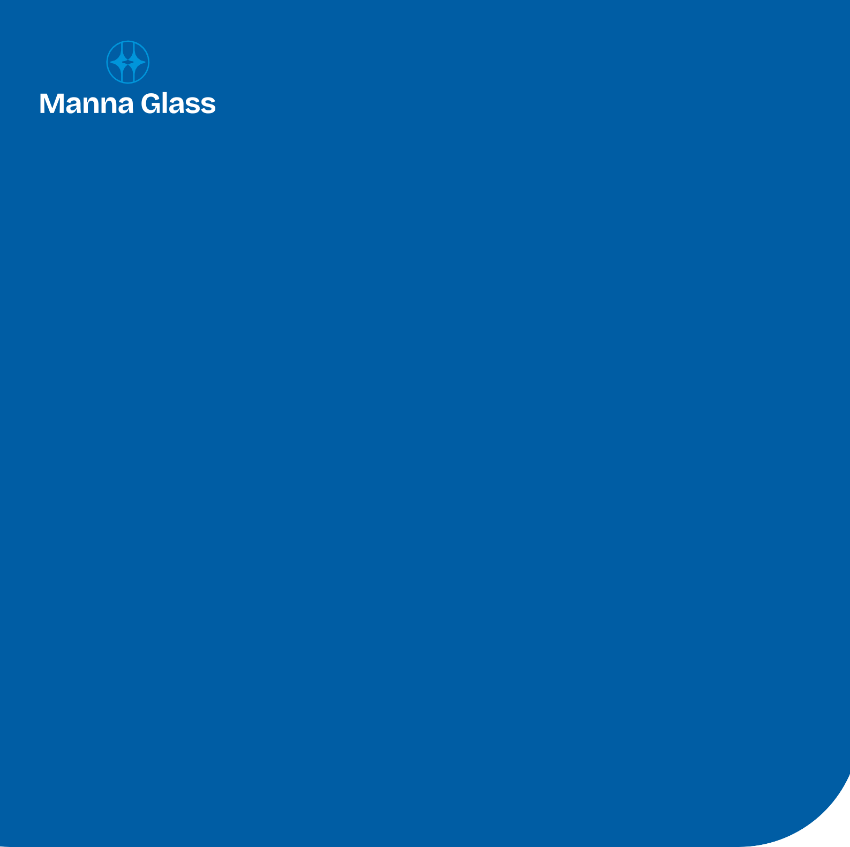

CENTRAL REGION
RIYADH
Headquarters, Branches, Accessories, IGU & Glass Factories, Project Division
AL KHARJ
Branch
BURAIDAH
Branch
ONAIZA
Branch
HAIL
Branch
NORTH WESTERN REGION
TABUK
Glass Factory & Branch
WESTERN REGION
JEDDAH
Mega Factory (65,000 m²)
-Opening 2027
MAKKAH
Branch & Tempered Glass Factory
MADINAH
Branches, IGU & Tempered Glass Factories
TAIF
Branch
YANBU
Branch
AL QUNFUDAH
Branch
NORTHERN REGION
SKAKA
Branch
EASTERN REGION
DAMMAM
Branches, Accessories & Tempered Glass Factory
AL AHSA
Branch
HAFAR AL-BATIN
Branch
EAST RIYADH – AL SULAY
Accessories Branch
UAE REGION
SHARJAH
JMG, a Manna Glass Company
AJMAN
JMG, a Manna Glass Company
SHARJAH
Hub Warehouse - Opening 2027
AJMAN
Accessories Showroom
Opening 2027
ABU DHABI
Accessories Showroom
Opening 2027
SOUTHERN REGION
KHAMIS MUSHAYT
Branch & Accessories
NAJRAN
Branch
GIZAN
Branch & Accessories
AL BAHA
Branch
GCC EXPANSION
KUWAIT CITY
Branch - Opening 2027
BAHRAIN
Branch - Opening 2027
MUSCAT, OMAN
Branch - Opening 2027
SOUTH WEST COAST REGION
GIZAN
Warehouse
www.mannaglass.sa
WE ARE HERE WHEN YOU NEED US.
Our Technical team is ready to support you and advise on your specific project requirements:
tech.projects@mannaglass.sa or products.glass@mannaglass.sa
All technical information and performance values are provided for general guidance only and may vary depending on application and installation conditions. Manna Glass reserves the right to modify specifications and product details without prior notice. Images shown may include illustrative representations.

